Slide 1
Operating System Structures
Chapter #2
Course Instructor: Nausheen Shoaib

Slide 2
Operating System Services
One set of operating-system services provides functions that are helpful to the user:
User interface - Almost all operating systems have a user interface (UI).
Varies between Command-Line (CLI), Graphics User Interface (GUI), Batch
Program execution - The system must be able to load a program into memory and to run that program, end execution, either normally or abnormally (indicating error)
I/O operations - A running program may require I/O, which may involve a file or an I/O device

Slide 3
Operating System Services (Cont.)
File-system manipulation - The file system is of particular interest. Programs need to read and write files and directories, create and delete them, search them, list file Information, permission management.
Communications – Processes may exchange information, on the same computer or between computers over a network
Communications may be via shared memory or through message passing (packets moved by the OS)
Error detection – OS needs to be constantly aware of possible errors
May occur in the CPU and memory hardware, in I/O devices, in user program
For each type of error, OS should take the appropriate action

Slide 4
Operating System Services (Cont.)
Resource allocation - When multiple users or multiple jobs running concurrently, resources must be allocated to each of them
Many types of resources - CPU cycles, main memory, file storage, I/O devices.
Accounting - To keep track of which users use how much and what kinds of computer resources
Protection and security - The owners of information stored in a multiuser or networked computer system may want to control use of that information, concurrent processes should not interfere with each other
Protection involves ensuring that all access to system resources is controlled
Security of the system from outsiders requires user authentication, extends to defending external I/O devices from invalid access attempts

Slide 5
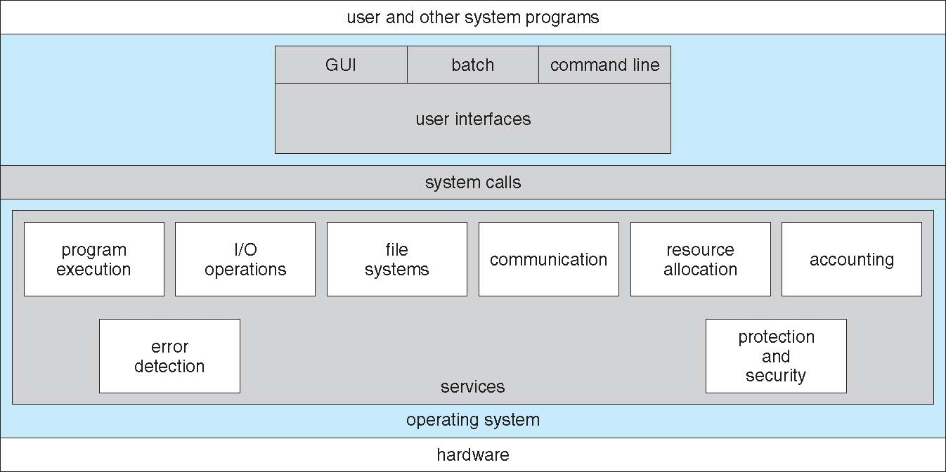
A View of Operating System Services

Slide 6
User Operating System Interface - CLI
CLI or command interpreter allows direct command entry
Sometimes multiple flavors implemented – shells
Primarily fetches a command from user and executes it
Sometimes commands built-in, sometimes just names of programs

Slide 7
User Operating System Interface - GUI
User-friendly desktop metaphor interface
Usually mouse, keyboard, and monitor
Icons represent files, programs, actions, etc
Various mouse buttons over objects in the interface cause various actions (provide information, options, execute function, open directory (known as a folder)
Many systems now include both CLI and GUI interfaces
Unix and Linux have CLI with optional GUI interfaces (CDE, KDE, GNOME)

Slide 8
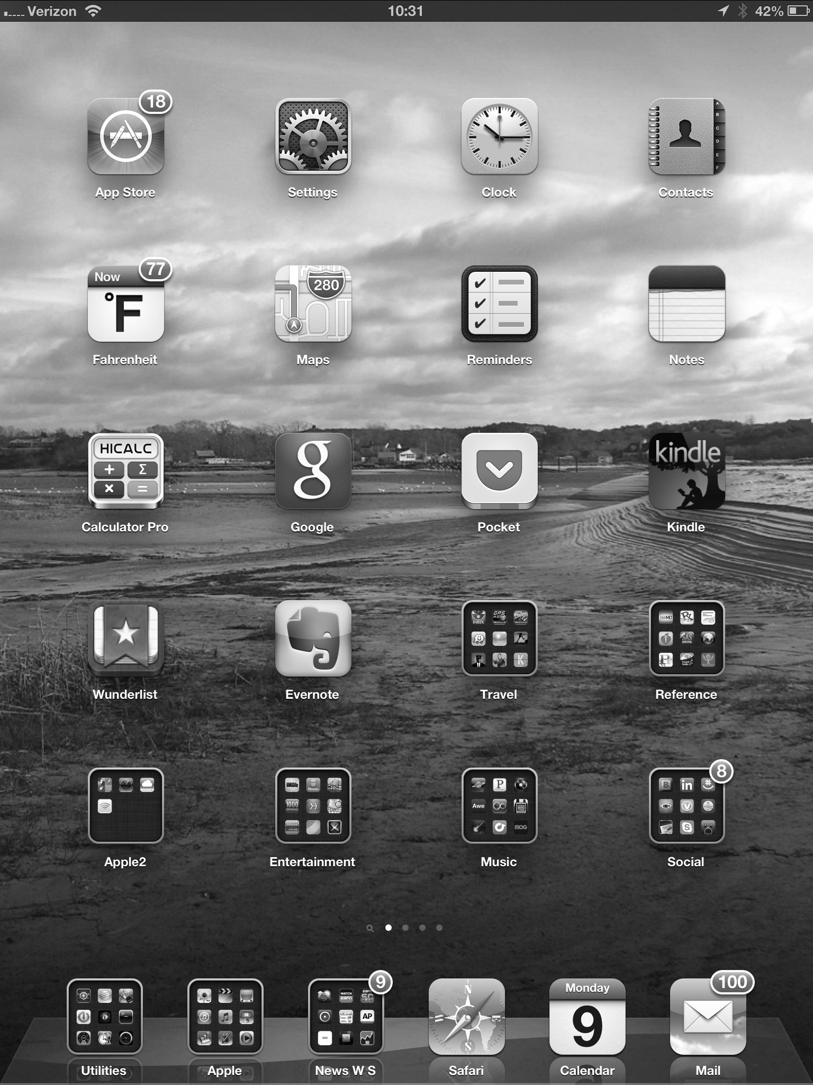
Touchscreen Interfaces
Touchscreen devices require new interfaces
Mouse not possible or not desired
Actions and selection based on gestures
Virtual keyboard for text entry
Voice commands.

Slide 9
System Calls
Programming interface to the services provided by the OS
Typically written in a high-level language (C or C++)
Mostly accessed by programs via a high-level Application Programming Interface (API) rather than direct system call use
Three most common APIs are Win32 API for Windows, POSIX API for POSIX-based systems (including virtually all versions of UNIX, Linux, and Mac OS X), and Java API for the Java virtual machine (JVM)

Slide 10
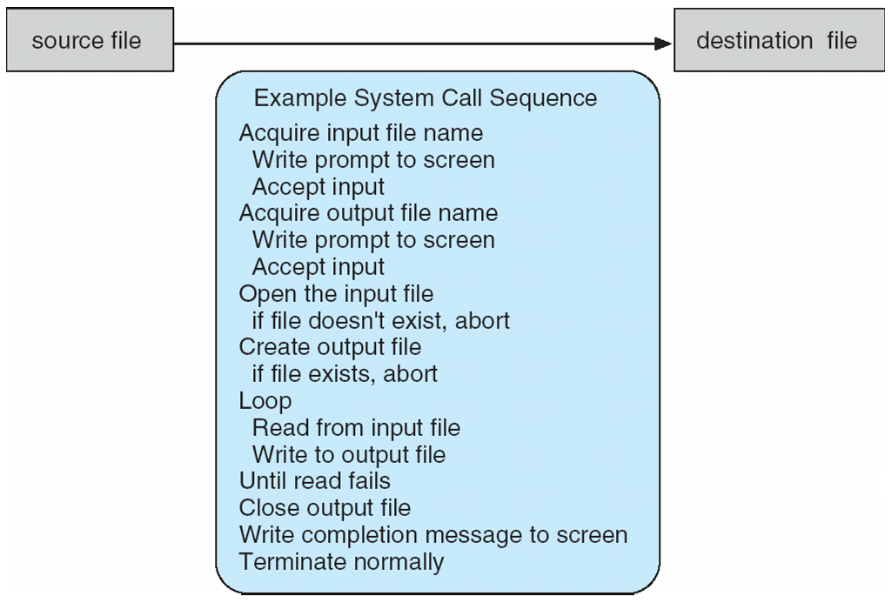
Example of System Calls
System call sequence to copy the contents of one file to another file

Slide 11
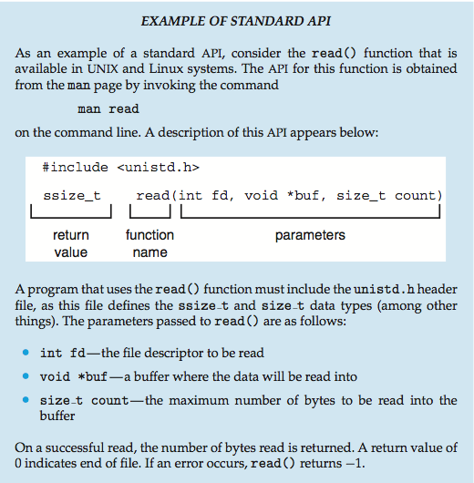
Example of Standard API

Slide 12
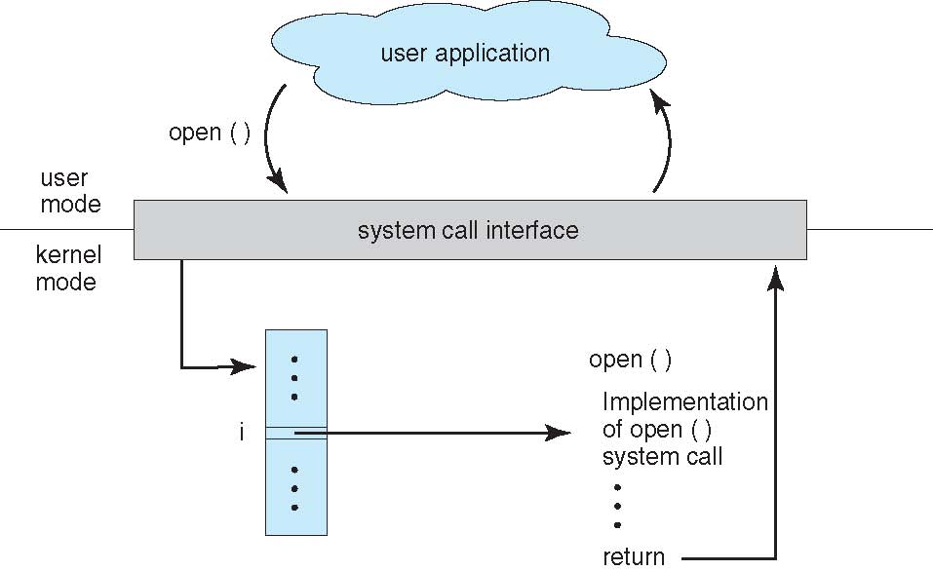
API – System Call – OS Relationship

Slide 13
System Call Parameter Passing
Three general methods used to pass parameters to the OS
Simplest: pass the parameters in registers
Parameters stored in a block, or table, in memory, and address of block passed as a parameter in a register
Parameters placed, or pushed, onto the stack by the program and popped off the stack by the operating system

Slide 14
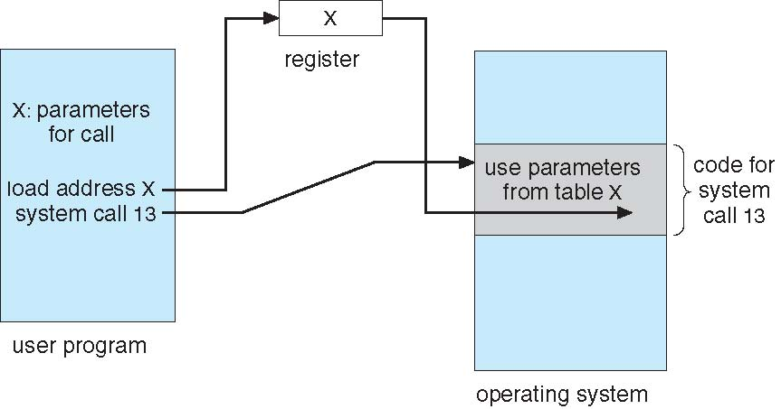
System Call Parameter Passing via Table

Slide 15
Types of System Calls
System calls can be roughly grouped into
five major categories:
Process Control
File management
Device Management
Information Maintenance
Communication

Slide 16
Types of System Calls
1.Process Control
load
execute
create process (for example, fork on Unix-like systems or NtCreateProcess in the Windows NT Native API)
terminate process
get/set process attributes
wait for time, wait event, signal event
allocate free memory

Slide 17
Types of System Calls
2.File management
create file, delete file
open, close
read, write, reposition
get/set file attributes
3.Device Management
request device, release device
read, write, reposition
get/set device attributes
logically attach or detach devices

Slide 18
Types of System Calls
4.Information Maintenance
get/set time or date
get/set system data
get/set process, file, or device attributes
5.Communication
create, delete communication connection
send, receive messages
transfer status information
attach or detach remote device

Slide 19
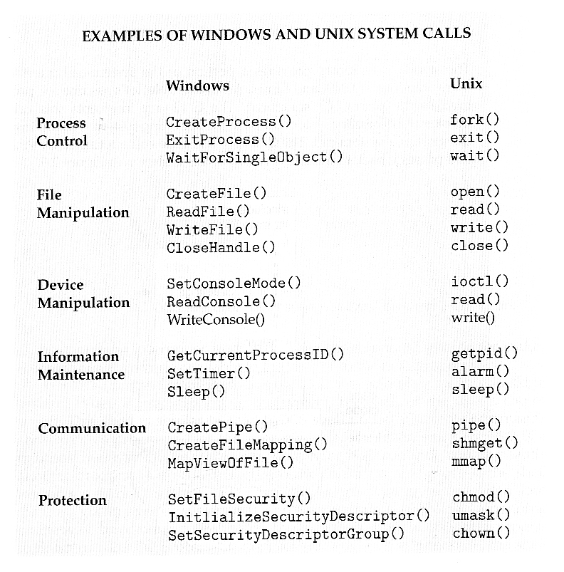

Slide 20
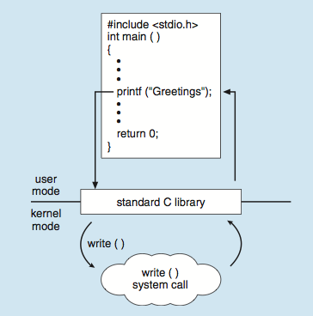
Standard C Library Example
C program invoking printf() library call, which calls write() system call

Slide 21
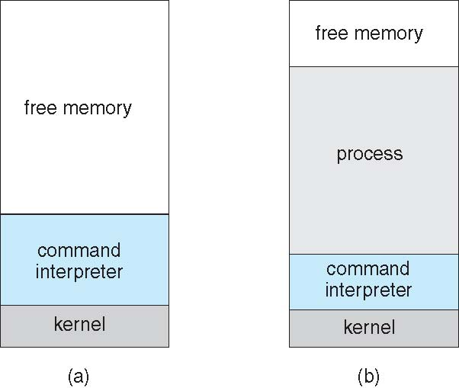
Example: MS-DOS
Single-tasking
Shell invoked when system booted
Simple method to run program
No process created
Single memory space
Loads program into memory, overwriting all but the kernel
Program exit -> shell reloaded
At system startup running a program

Slide 22
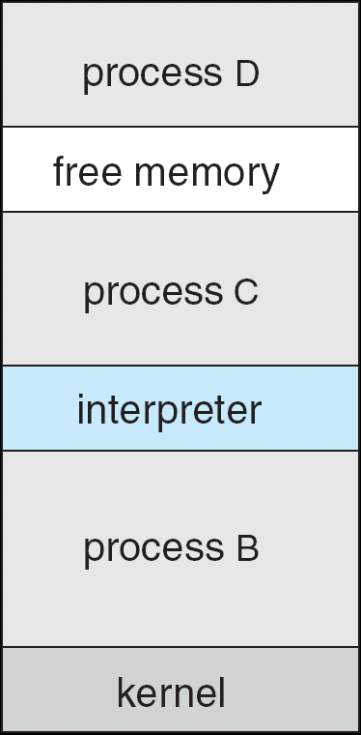
Example: FreeBSD
Unix variant
Multitasking
User login -> invoke user’s choice of shell
Shell executes fork() system call to create process
Executes exec() to load program into process
Shell waits for process to terminate or continues with user commands
Process exits with:
code = 0 – no error
code > 0 – error code

Slide 23
System Programs
System programs provide a convenient environment for program development and execution. They can be divided into:
File manipulation
Status information sometimes stored in a File modification
Programming language support
Program loading and execution
Communications
Background services
Application programs

Slide 24
System Programs
File management - Create, delete, copy, rename, print, dump, list, and generally manipulate files and directories
Status information
Some ask the system for info - date, time, amount of available memory, disk space, number of users
Others provide detailed performance, logging, and debugging information

Slide 25
System Programs (Cont.)
File modification
Text editors to create and modify files
Special commands to search contents of files or perform transformations of the text
Programming-language support - Compilers, assemblers, debuggers and interpreters sometimes provided
Program loading and execution- debugging systems for higher-level and machine language
Communications - Provide the mechanism for creating virtual connections among processes, users, and computer systems

Slide 26
System Programs (Cont.)
Background Services
Launch at boot time
Provide facilities like disk checking, process scheduling, error logging, printing
Run in user context not kernel context
Known as services, subsystems, daemons
Application programs
Run by users

Slide 27
Linkers and Loaders
Source code compiled into object files designed to be loaded into any physical memory location – relocatable object file
Linker combines these into single binary executable file
Also brings in libraries
Program resides on secondary storage as binary executable
Must be brought into memory by loader to be executed
Relocation assigns final addresses to program parts and adjusts code and data in program to match those addresses
Modern general purpose systems don’t link libraries into executables
Rather, dynamically linked libraries (in Windows, DLLs) are loaded as needed, shared by all that use the same version of that same library (loaded once)
Object, executable files have standard formats, so operating system knows how to load and start them

Slide 28
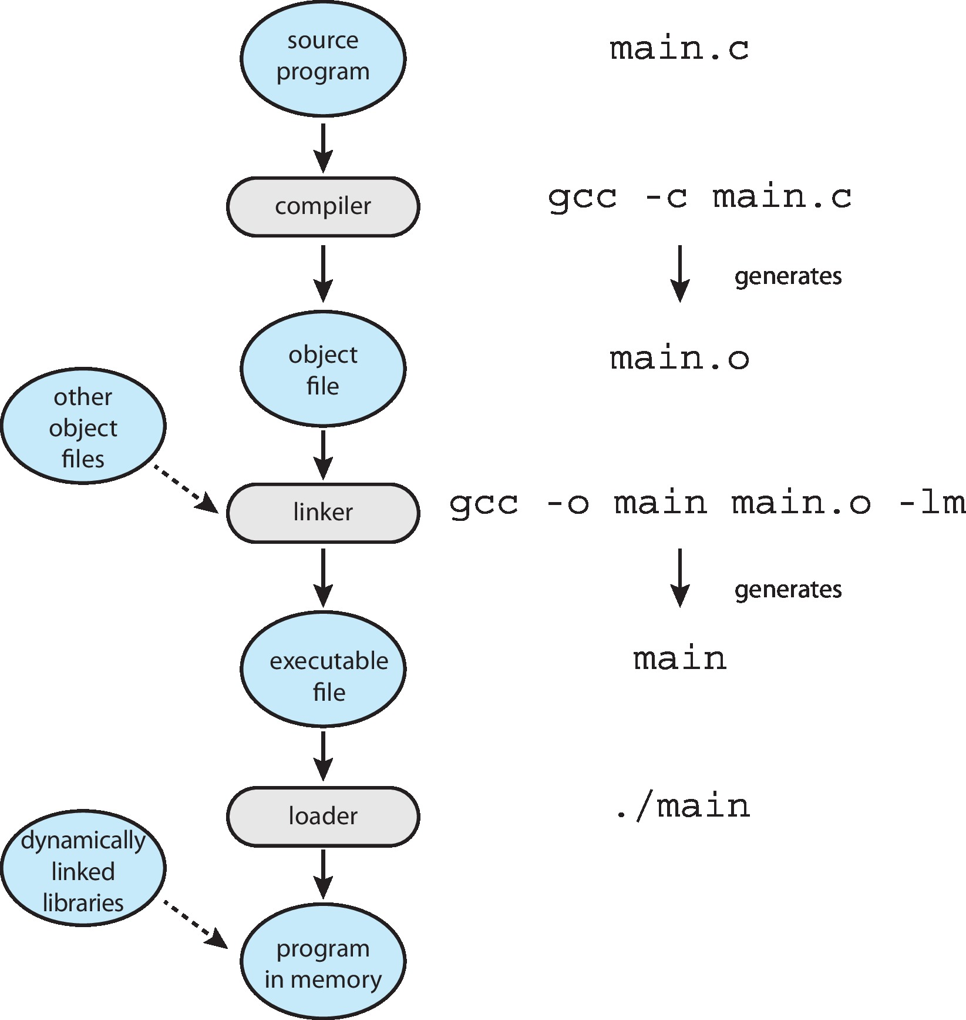
The Role of the Linker and Loader

Slide 29
Why Applications are Operating System Specific
Apps compiled on one system usually not executable on other operating systems
Each operating system provides its own unique system calls
Own file formats, etc
Apps can be multi-operating system
Written in interpreted language like Python, Ruby, and interpreter available on multiple operating systems
App written in language that includes a VM containing the running app (like Java)
Use standard language (like C), compile separately on each operating system to run on each
Application Binary Interface (ABI) is architecture equivalent of API, defines how different components of binary code can interface for a given operating system on a given architecture, CPU, etc

Slide 30
Operating System Design and Implementation
Start the design by defining goals and specifications
Affected by choice of hardware, type of system
User goals and System goals
User goals – operating system should be convenient to use, easy to learn, reliable, safe, and fast
System goals – operating system should be easy to design, implement, and maintain, as well as flexible, reliable, error-free, and efficient

Slide 31
Implementation
Much variation
Early OSes in assembly language
Then system programming languages like Algol, PL/1
Now C, C++
Actually usually a mix of languages
Lowest levels in assembly
Main body in C
Systems programs in C, C++, scripting languages like PERL, Python, shell scripts
More high-level language easier to port to other hardware
But slower
Emulation can allow an OS to run on non-native hardware

Slide 32
Operating System Design and Implementation (Cont.)
Important principle to separate
Policy: What will be done? Mechanism: How to do it?
Mechanisms determine how to do something, policies decide what will be done
The separation of policy from mechanism is a very important principle, it allows maximum flexibility if policy decisions are to be changed later (example – timer)

Slide 33
Operating System Structure
There are six different structures:
Simple Structure
Layered Systems
Microkernels
Modules
Hybrid Machines

Slide 34
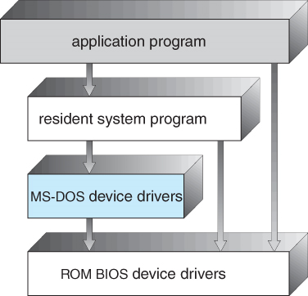
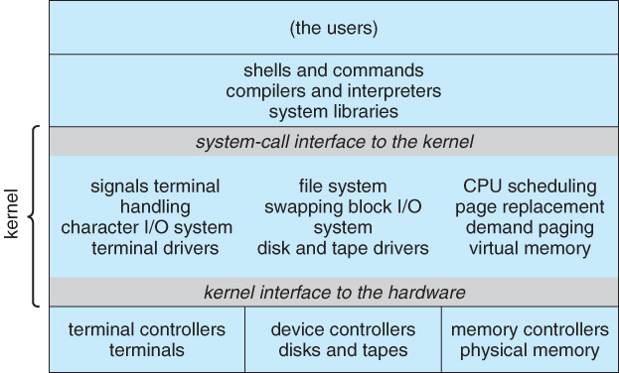
Operating System Structure
1.Monolithic Structure:
DOS has no modern software engineering techniques,
Does not break the system into subsystems, and has no distinction between user and kernel modes.
Allow all programs direct access to hardware.
Fig: MS-DOS layer structure
Fig: Traditional UNIX system structure

Slide 35
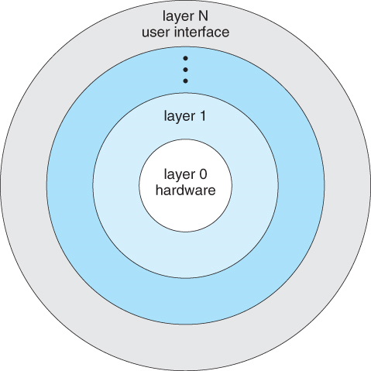
Operating System Structure
2.Layered Approach:
Another approach is to break the OS into
number of smaller layers and relies on the
services provided by next lower layer.
allows each layer to be developed and
debugged independently, with assumption
that all lower layers is already debugged.
The problem is deciding what order in which
to place the layers, as no layer can call upon the services of any higher layer.
Layered approaches can also be less efficient, as a request for service from a higher layer has to filter through all lower layers before it reaches the HW, possibly with significant processing at each step.

Slide 36
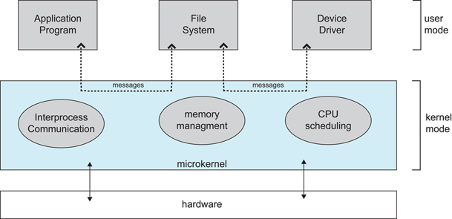
Operating System Structure
3.Microkernels:
micro kernels is to remove all non-essential services from the kernel, and implement them as system applications
provide basic process and
memory management, and message
passing between other services
Security and protection can be
enhanced, as most services are
performed in user mode, not kernel
mode.
System expansion can also be easier, because it only involves adding more system applications, not rebuilding a new kernel.
Mach, Windows NT are examples of kernel

Slide 37
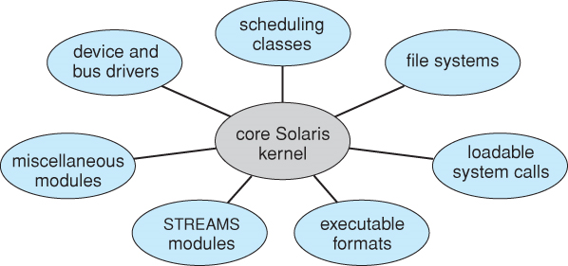
Operating System Structure
4.Modules
Modern OS development is object-oriented, with a relatively small core kernel and a set of modules which can be linked in dynamically.
Modules are similar to layers
in that each subsystem has
clearly defined tasks and
interfaces.
The kernel is relatively small in this architecture, similar to microkernels, but the kernel does not have to implement message passing since modules are free to contact each other directly.

Slide 38
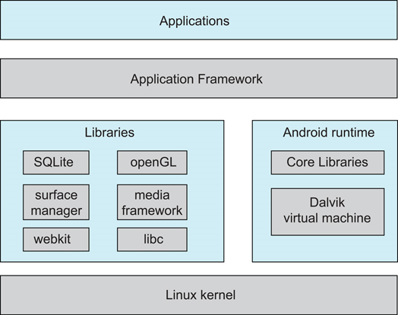
Operating System Structure
5.Hybrid Systems:Most OS today do not strictly
adhere to one architecture, but are hybrids of
several.
Android:
open-source OS
includes versions of Linux
and a JVM
apps are developed using
Java

Slide 39
Operating-System Debugging
Debugging is finding and fixing errors, or bugs
OS generate log files containing error information
Failure of an application can generate core dump file capturing memory of the process
Operating system failure can generate crash dump file containing kernel memory
Kernighan’s Law: “Debugging is twice as hard as writing the code in the first place. Therefore, if you write the code as cleverly as possible, you are, by definition, not smart enough to debug it.”

Slide 40
Operating System Generation
SYSGEN program obtains information concerning the specific configuration of the hardware system
Used to build system-specific compiled kernel or system-tuned

